Slide 1

Intro to Baskerville
EPSRC Tier 2 HPC System
University of Birmingham

Slide 2
Overview
Baskerville websites and resources
Preview of what will be covered in these training sessions

Slide 3
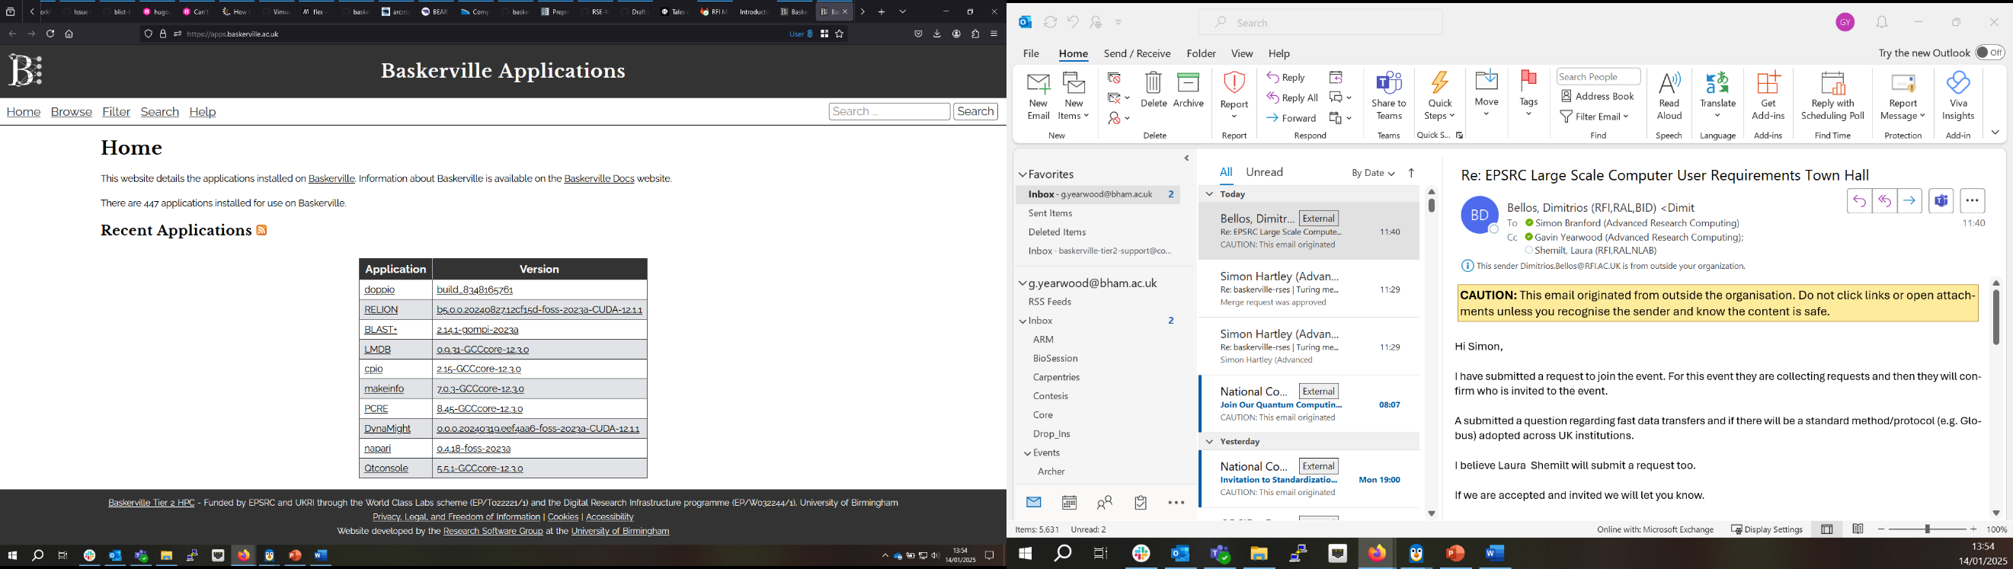
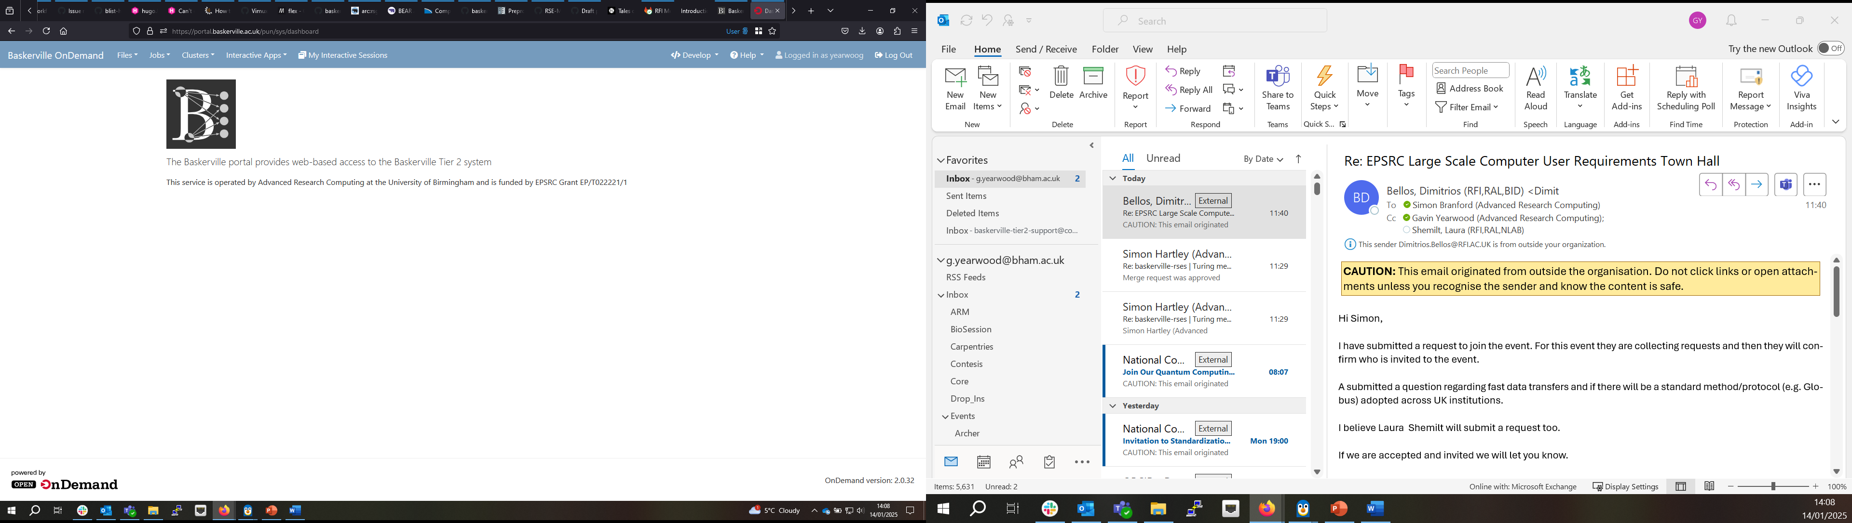
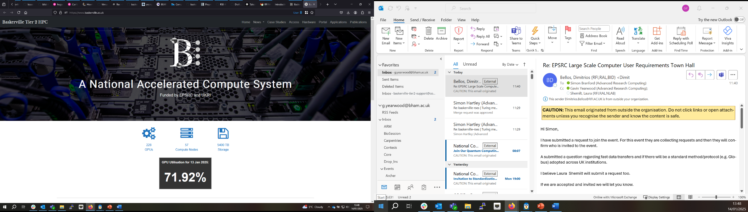
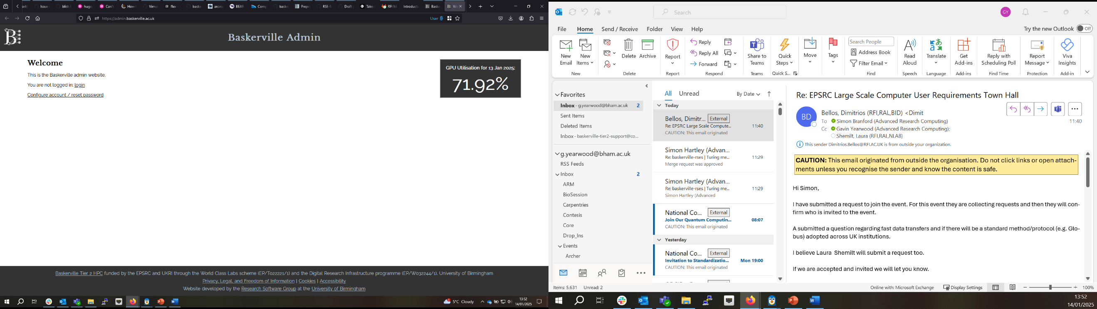
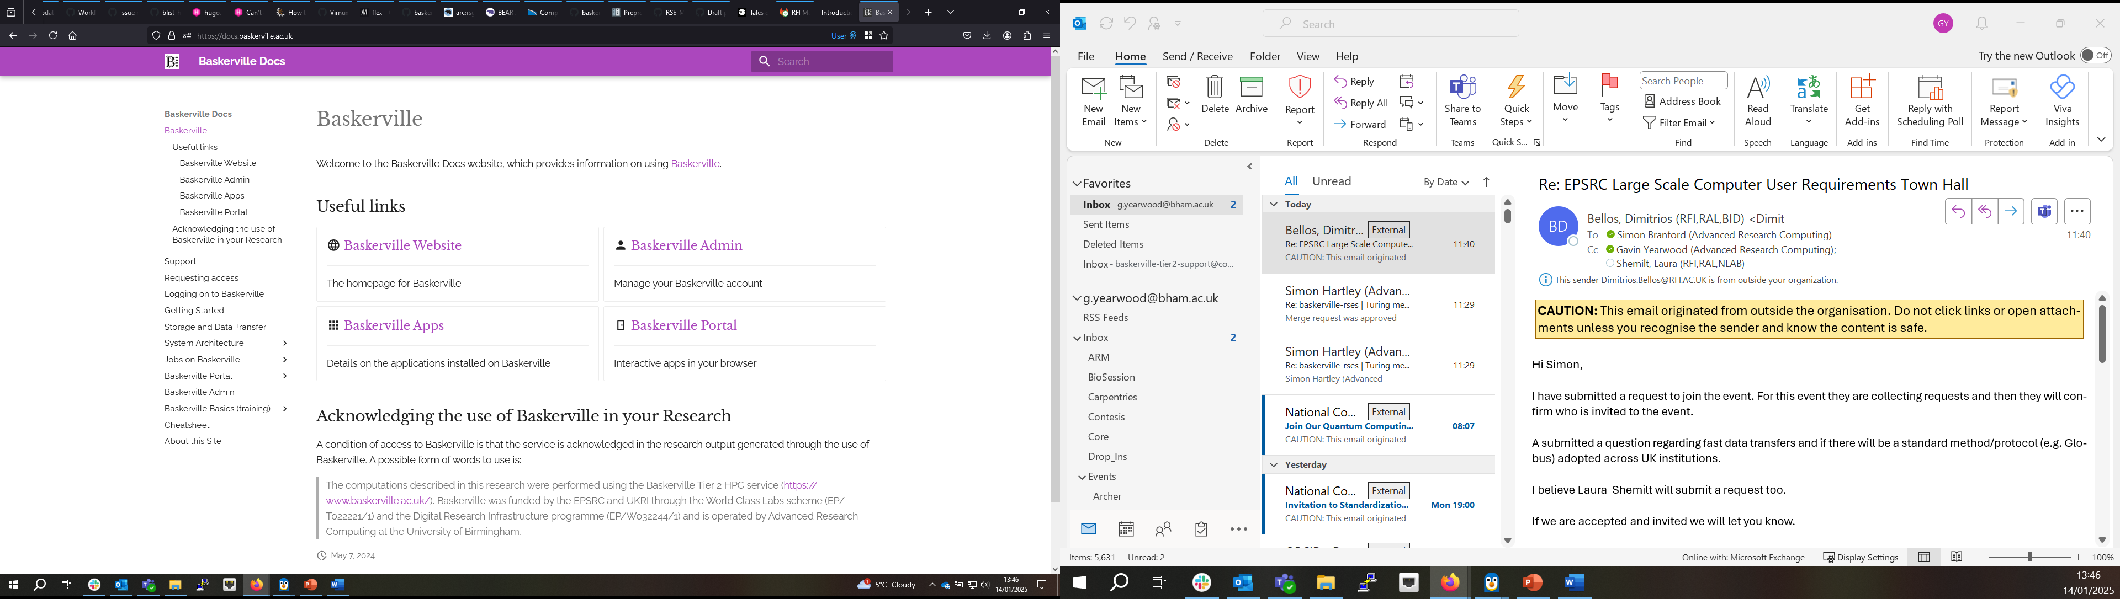
Baskerville Resources

Slide 4
Baskerville Docs Site
First point of contact for Baskerville information
Examples:
Batch jobs
Interactive jobs
Parallel jobs
Hardware information
Videos
Baskerville Basics
Links for who you should contact for support

Slide 5
Baskerville Nomenclature
HPC = High Performance Computer
HTC = High Throughput Computing
Jobs = Programs, applications and/or simulations that you run
SLURM = Simple Linux Utility for Resource Management which is the job scheduler
Job scheduler = Allows multiple people to use the shared resource and allows these jobs to run in an efficient manner

Slide 6
Baskerville Nomenclature 2
QoS = Quality of Service for you this is the site you part of and controls partition of jobs
Login node = Where you start, no GPUs it is where you submit jobs
Compute node = Node that does the work

Slide 7

High Performance Computing (HPC) typically involves connecting to very large computing systems elsewhere in the world.
These other systems can be used to do work that would either be impossible or much slower on smaller systems.
HPC resources are shared by multiple users.
The standard method of interacting with such systems is via a command line interface.

Slide 8
Baskerville HPC
228 A100 GPUs
57 Compute Nodes
11 A100-80 GPU nodes
46 A100-40 GPU nodes
5,400 TB Storage
SLURM scheduler

Slide 9
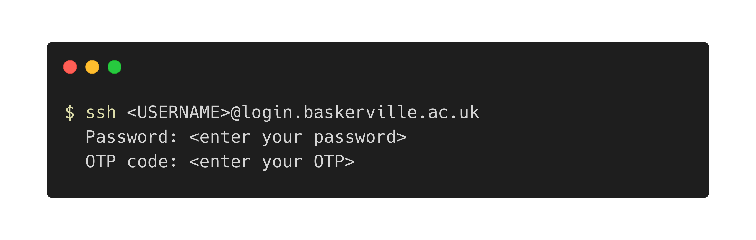
Connect using an SSH Client. Or via https://portal.baskerville.ac.uk
Windows: PuTTY | MobaXterm | Windows Subsystem for Linux
MacOS or Linux: Terminal
Note: OTP – One Time Passcode

Slide 10

Logging in example video

Slide 11
Baskerville User
Home space:
20 GB
For settings, ssh keys etc
Not for storing data
This size does not change
Project space
At least 1 TB
Should be for data, job scripts, output etc
Can be assigned to multiple projects
Project controls QoS

Slide 12
User information
admin.baskerville.ac.uk/ - Contains all your user about home space and project directories and details including full path.
Command line alternative
my_quota - contains home space utilisation
my_baskerville – projects, accounts and QoS information
bask-show-quota – shows space in how much space is in your home space and in active projects

Slide 13

User Details Video

Slide 14




Local: Your computer
Remote: Baskerville
you are here
LOGIN NODE
COMPUTE NODE
QUEUE
SSH
SLURM
STORAGE
Notes:
52 Compute nodes X 4 GPUS = 208 GPUs total
5400 TB Storage
Compute should only run on a compute node (through a batch/interactive job) and never on a login node

Slide 15
Jobs on Baskerville
Batch jobs
Create a job script and submit to the queue from the login node
Generates output files
https://docs.baskerville.ac.uk/jobs/
Interactive jobs
Command to run directly on the compute node
Default display on the command line
https://docs.baskerville.ac.uk/interactive-jobs/

Slide 16
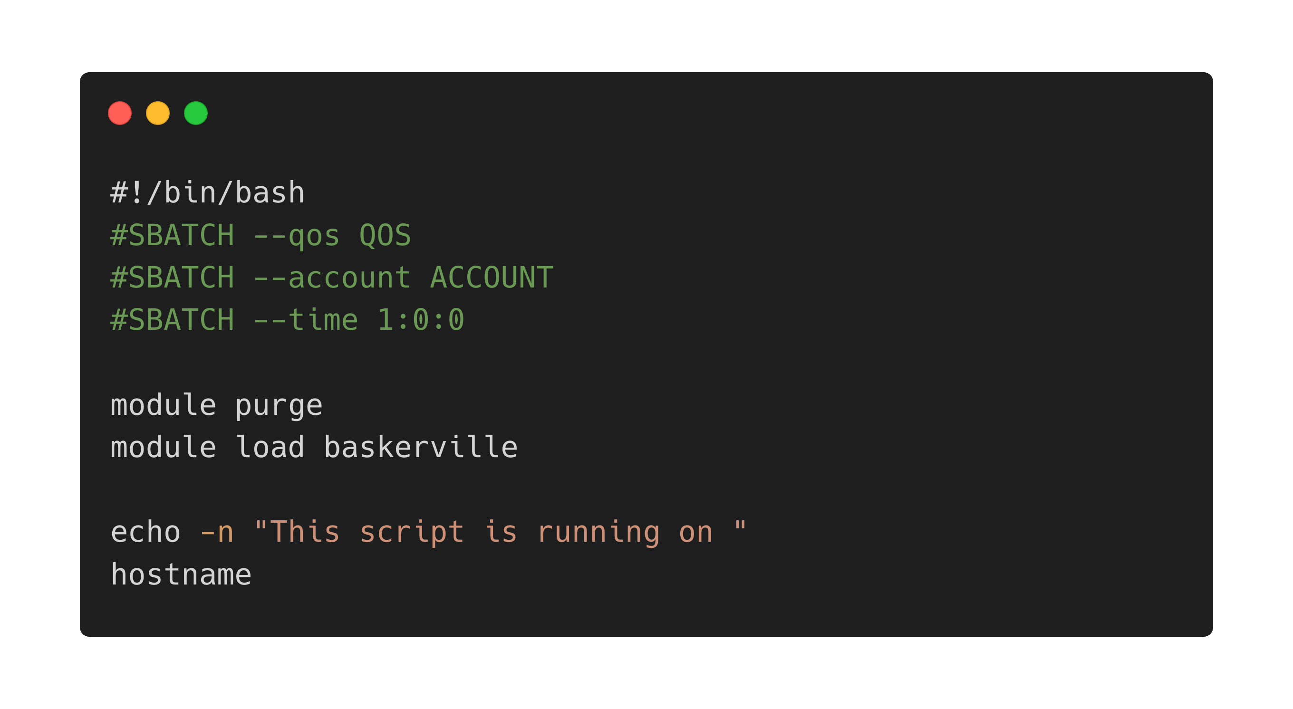
Create your job script
Notes:
Shebang: use bash shell
Header: resource requests
Body: commands to execute
module loading will be addressed in the next section
echo –n : flag suppresses \n

Slide 17
Let’s look at the job script again
module purge unloads and loaded modules and resets the environment
module load baskerville loads the default Baskerville environment
Notes:
A module is a self-contained software package and includes required dependences. They are optimized for use on Baskerville.

Slide 18
Baskerville modules
Baskerville team will install applications upon request
We have https://apps.baskerville.ac.uk/ for you to search for available applications
Command line options module avail and module spider

Slide 19
Storage
Baskerville is not backed up and is not suitable for long term-data storage
Temporary scratch storage location useful for jobs with significant IO - https://docs.baskerville.ac.uk/storage/#temporary-scratch-storage
/tmp
/scratch-global

Slide 20
Data Transfer
https://docs.baskerville.ac.uk/storage/#data-transfer
Main methods:
Baskerville portal file system
Rsync - https://linuxize.com/post/how-to-use-rsync-for-local-and-remote-data-transfer-and-synchronization
Globus

Slide 21
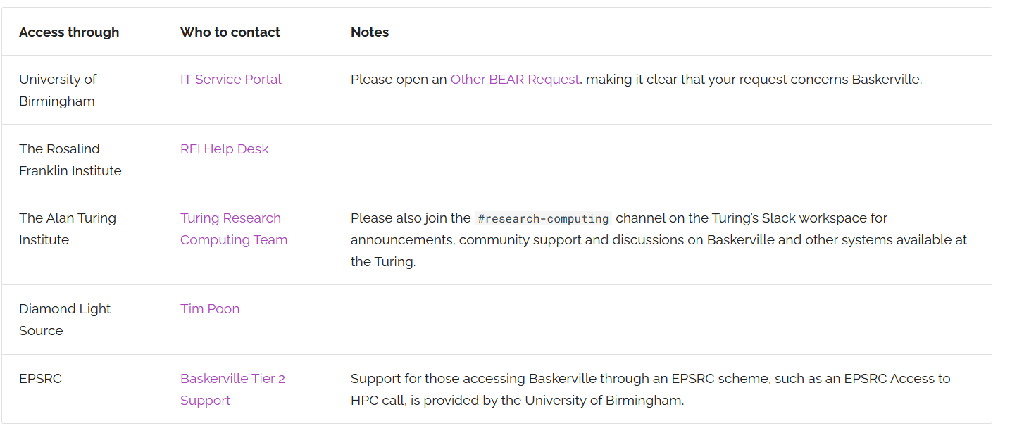
Baskerville Support
Each site has a point of contact from https://docs.baskerville.ac.uk/support/#who-to-contact :

Slide 22
Baskerville Debugging
Check that it is using the GPU
GPU check in code
Nvidia-smi
NVDashboard
Increase number of resources allocated to job (cores, memory or GPUs)

Slide 23
Acknowledging Baskerville
“The computations described in this research were performed using the Baskerville Tier 2 HPC service (https://www.baskerville.ac.uk/). Baskerville was funded by the EPSRC and UKRI through the World Class Labs scheme (EP/T022221/1) and the Digital Research Infrastructure programme (EP/W032244/1) and is operated by Advanced Research Computing at the University of Birmingham.”
If you let us know we will add you to our publications page - https://www.baskerville.ac.uk/publications.html

Slide 24

Thank you any Questions
Useful links:
https://docs.baskerville.ac.uk/
https://admin.baskerville.ac.uk/
https://apps.baskerville.ac.uk/
https://portal.baskerville.ac.uk/
https://github.com/baskerville-hpc/intro-to-baskerville
Email:
baskerville-tier2-support@contacts.bham.ac.uk

